Slide 1
Communication
Writing in English
Mistakes never to be made
Charlotte Binnemans
Koen Van Eyken

Slide 2
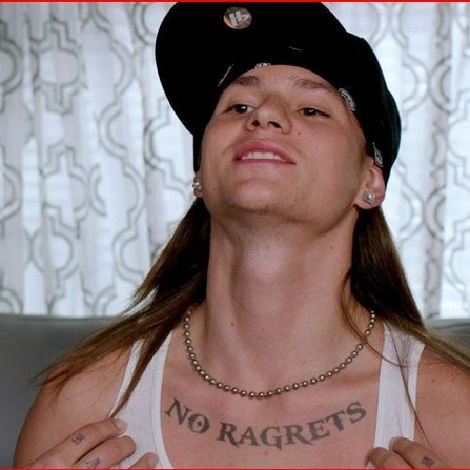
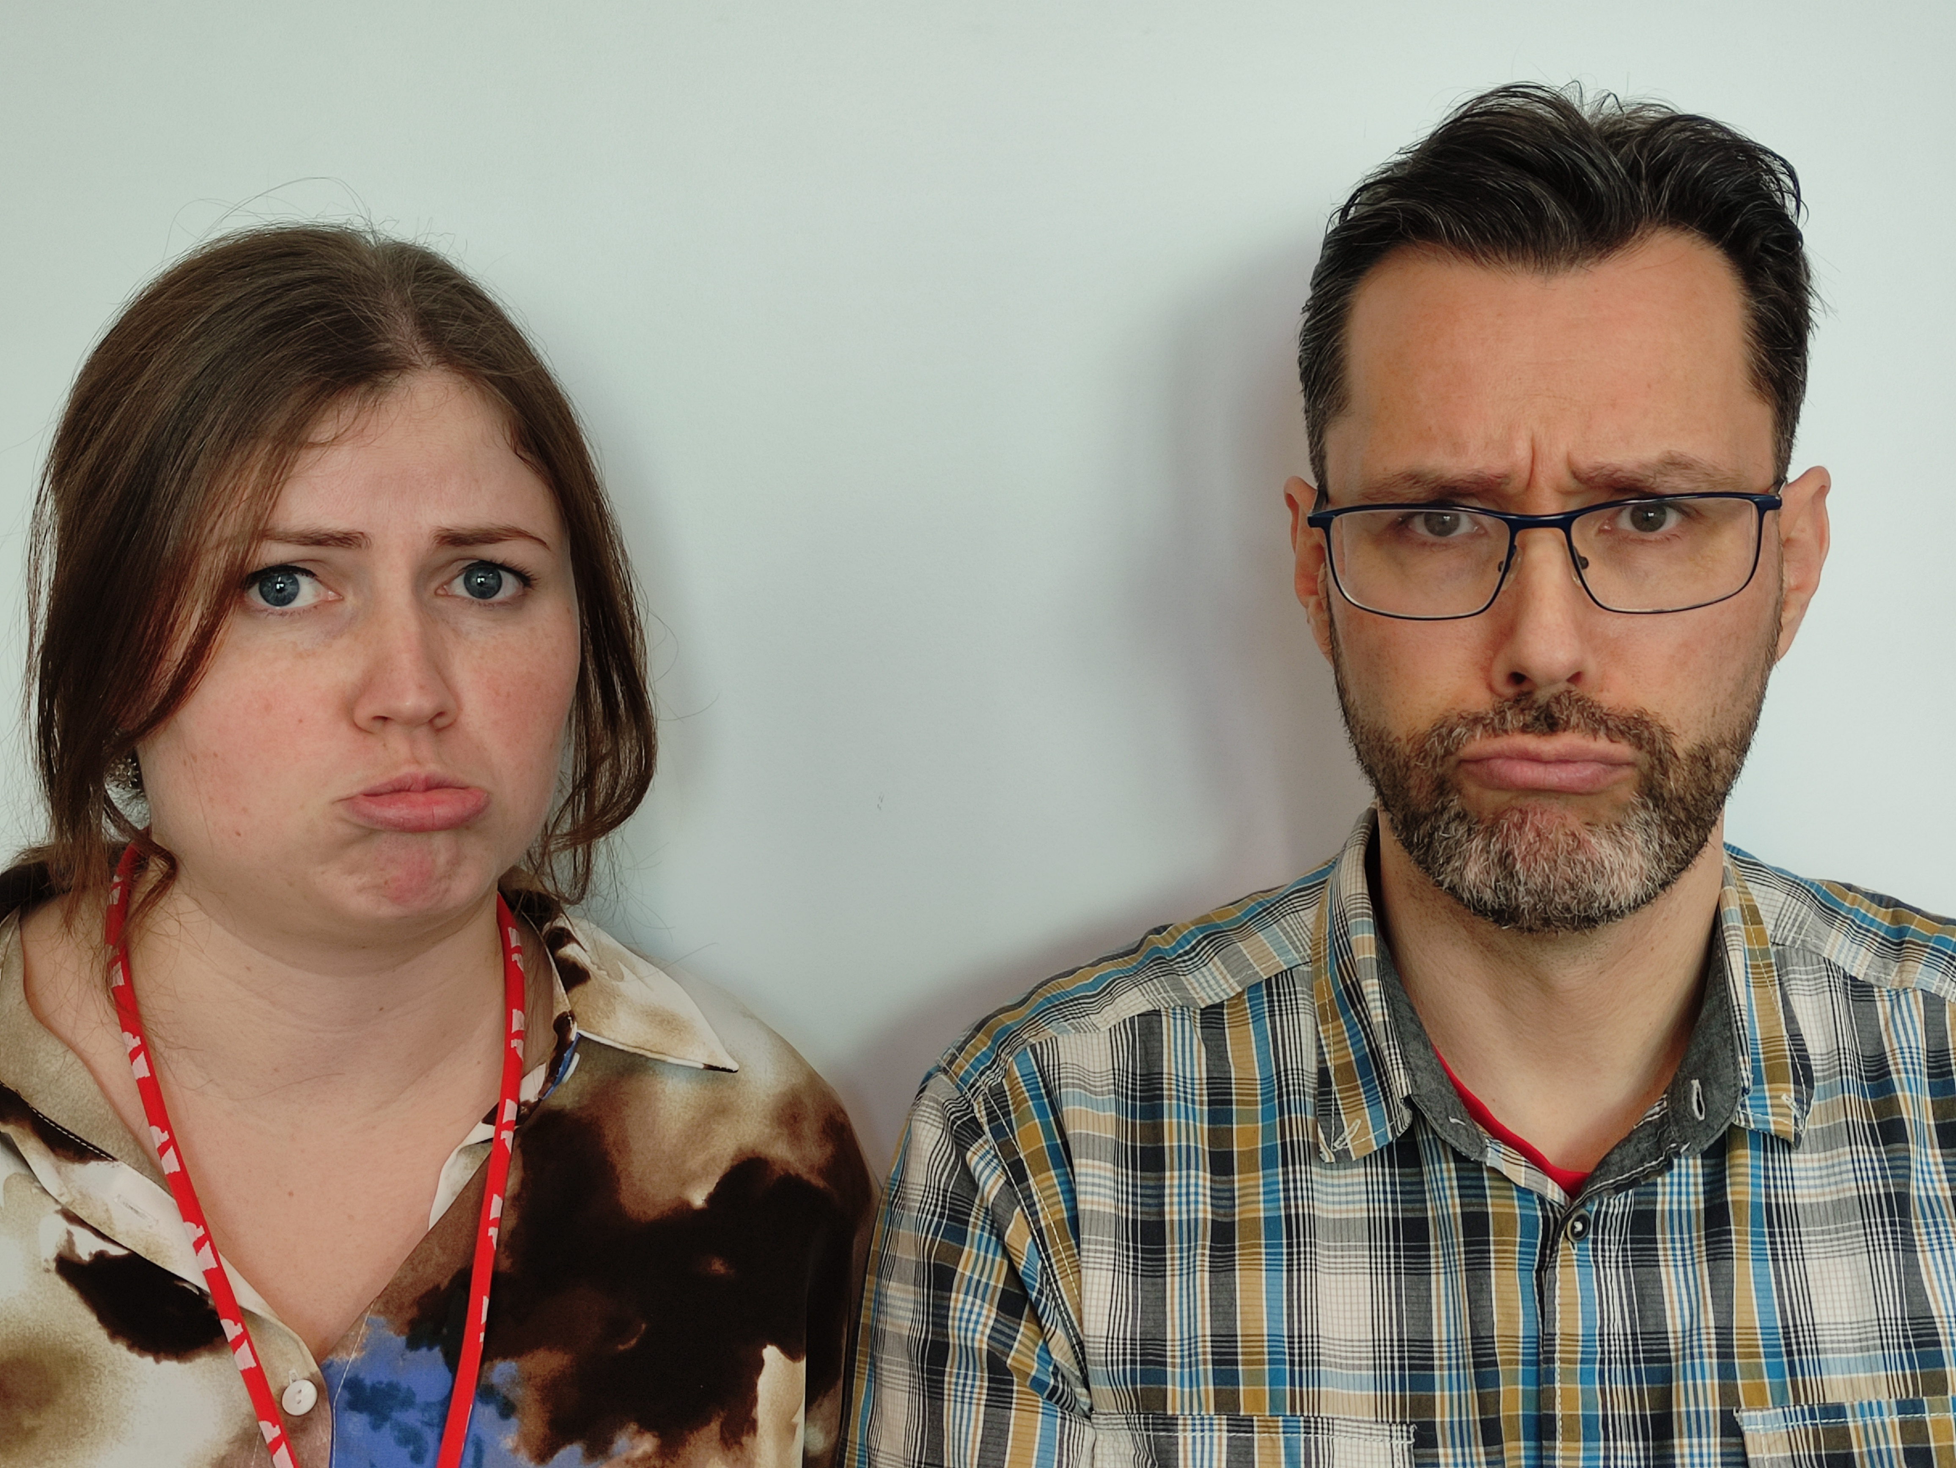
Mistakes never to be made
Journalism department: -2 per mistake on total!
IT department:
Lose points
Disappointed lecturers

Slide 3
Exercise
Write down what the difference is between these words. Explain when you use them.
To vs. too​
Then vs. than​
Your – you’re / where – we’re – were / ​
their – they’re – there​
Subject-verb agreement​
Adjective vs. Adverb
It's – its

Slide 4
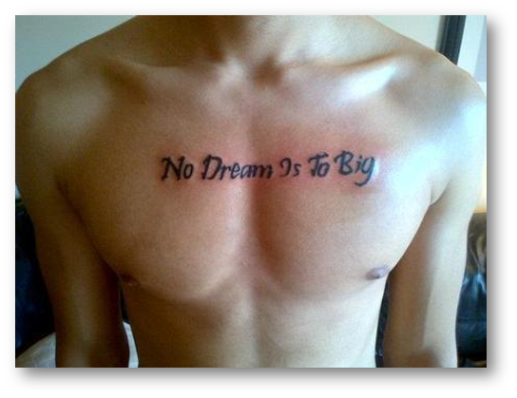
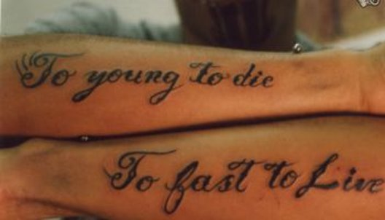
Mistakes never to be made

Slide 5
Too ←→ to
Too red ←→ to London​
Too soon ←→ something to do

Slide 6
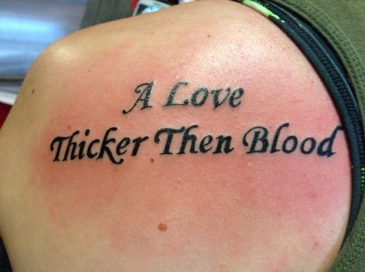
Mistakes never to be made

Slide 7
then ←→ than
Time ←→ comparison ​
Then she kissed me ←→ older than my brother

Slide 8
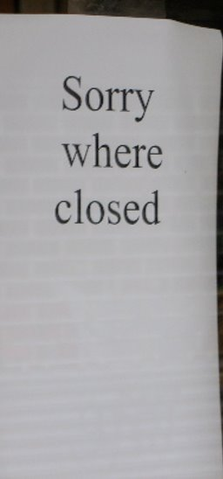
Mistakes never to be made

Slide 9
We’re ←→ were ←→ where
Verb form ←→ verb form ←→ place​
We’re fine ←→ we were fine ←→ Where am I?​
(We are fine)

Slide 10
they’re ←→ their ←→ there
Verb form ←→ possessive ←→ adverb​
They’re fine ←→ it is their car ←→ I’m not there​
There is a problem!​

Slide 11
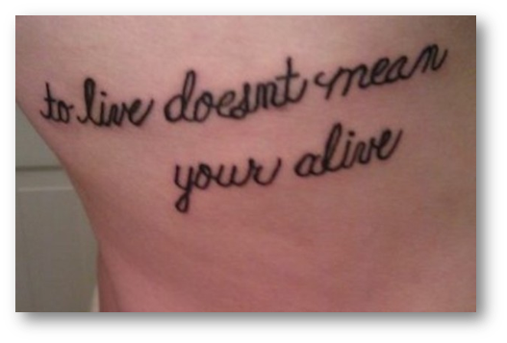
Mistakes never to be made

Slide 12
Your ←→ you’re
Possessive ←→ verb form ​
Your car ←→ you’re cool (you are cool) ​
Ur is not a word!!!!!

Slide 13
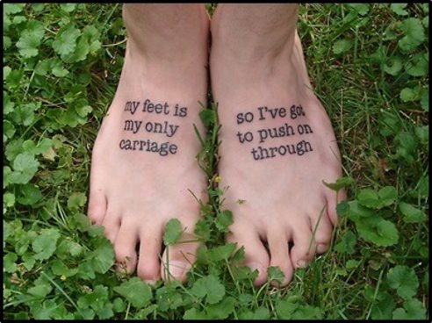

Mistakes never to be made

Slide 14
Subject verb agreement
A singular subject takes a singular verb, whereas a plural subject takes a plural verb​.
The list of items is on the desk.​
The items are on the desk.

Slide 15
Adjective vs adverb
Mostly: adjective + ly = adverb​
He is successful. ←→ He negotiated the deal successfully.
A heavy duty. ←→ A heavily engaged employee.
But: hard, fast, … → some adverbs don’t take –ly
Good = well. You did well!

Slide 16
Various
I is always with a capital letter.
A lot (NOT allot, alot).
Affect (verb) vs. Effect (the effect it has on me).
It's (it is), its (possessive).
...

Slide 17
Recap of mistakes never to be made
To vs. too​
Then vs. than​
Your – you’re / where – we’re – were / ​
their – they’re – there​
Subject-verb agreement​
Adjective vs. Adverb
Various

Slide 18
Questions?

